Slide 1
Canva Design :
Resume Creation and Designing.
Coach - Muneera M

Slide 2
1) What is Canva?
Canva is a graphic designing tool that can be used for professional development or for personal development.
It is a free design tool.
Completely brilliant!!! Yes, it’s got tons of photos, elements, and other graphics for you to use.
So, in other words, a complete lifesaver in the content marketing world.

Slide 3
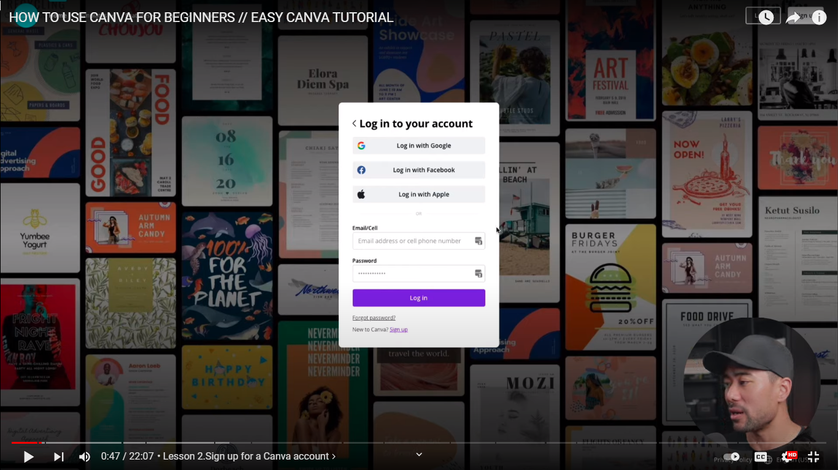
2) Mobile login & PC login

Slide 4
3) Pros :
Install the app on your phone.
Edit on the go.
Upload on the go.
Download designs straight to your device.

Slide 5
4) Cons:
A little difficult to see
Sometimes difficult to edit.

Slide 6
5) Explanations about Canva in the Canva app/website.
6) Resume editing in the Canva app/website.

Slide 7
Thank You

